Slide 1

Software Project Acquisition

Slide 2


Slide 3

Process of obtaining or acquiring a project for your organization.
It involves identifying potential projects, evaluating their feasibility, and taking the necessary steps to secure the project for execution.

Slide 4


Slide 5
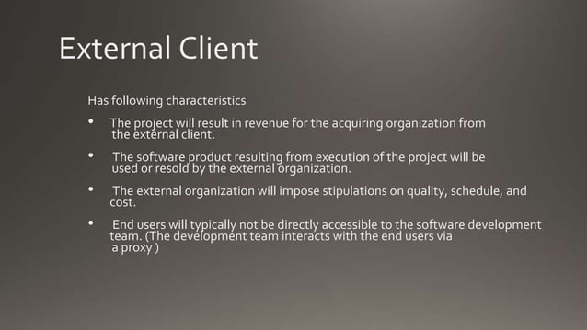

Slide 6
Internal Client
Has the following characteristics:
The project will result in value for the acquiring organization by fulfilling the needs of internal teams or departments.
The software product resulting from the project will be used within the organization and not resold.
The organization itself defines the quality, schedule, and cost constraints.
End users are typically within the same organization, allowing direct interaction between the development team and users for feedback and improvements.

Slide 7
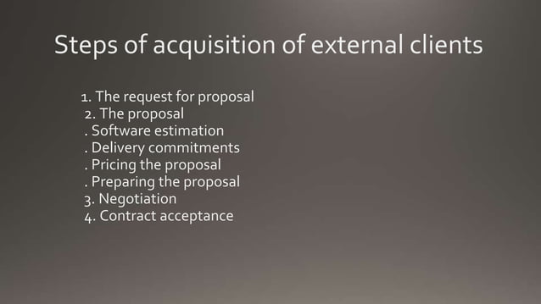

Slide 8
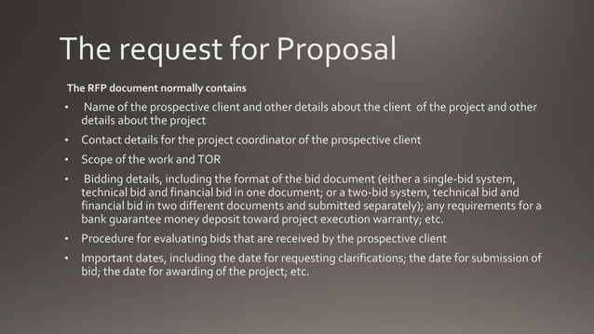

Slide 9


Slide 10


Slide 11


Slide 12
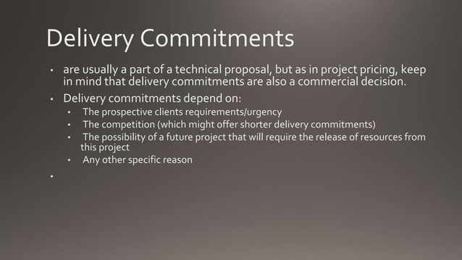

Slide 13


Slide 14


Slide 15
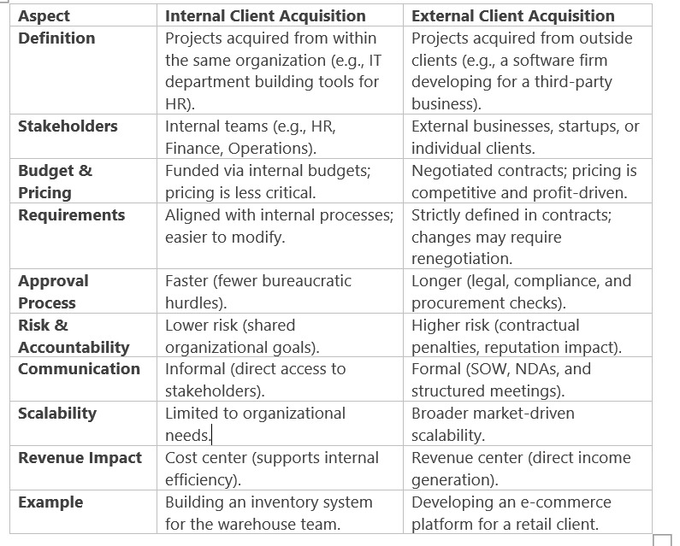

Slide 16
Project Acquisition from internal clients
It refers to the process of identifying, securing, and managing projects or work assignments within an organization, where the clients or project sponsors are individuals or teams from within the same organization.
This approach is common in larger organizations where different departments or teams may request or initiate projects to meet specific goals, solve problems, or improve internal processes. Here are key aspects of project acquisition from internal clients:
Client Identification: Internal clients can be various departments, teams, or individuals within the organization. These clients may include marketing, research and development, operations, human resources, or any other functional area within the company.

Slide 17
Project Acquisition from internal clients
Client Needs Assessment: To acquire projects from internal clients, it's essential to engage in a comprehensive needs assessment. This involves understanding the objectives, challenges, and requirements of the internal client.
Alignment with Organizational Goals: Projects from internal clients are expected to align with the broader strategic goals and mission of the organization. The projects should contribute to the success of the company as a whole.
Resource Allocation: Acquiring internal client projects often involves securing resources, both human and financial, to execute the project successfully. These resources may be shared or allocated specifically for the project.
Project Proposal: Internal clients typically present project proposals, outlining the project's scope, objectives, expected outcomes, and resource requirements. These proposals are evaluated for feasibility and alignment with organizational objectives.

Slide 18
Project Acquisition from internal clients
Budget and Cost Estimates: Project acquisition may also involve the estimation of project costs and the development of budgets. This is important for securing financial resources and tracking expenses.
Project Prioritization: Organizations may have limited resources, so project acquisition from internal clients often requires prioritization based on factors such as strategic importance, resource availability, and expected impact.
Project Management: Once a project is acquired, it is managed according to established project management methodologies, involving planning, execution, monitoring, and control.

Slide 19
Project Acquisition from internal clients
Communication and Collaboration: Effective communication and collaboration are crucial when acquiring projects from internal clients. Close coordination with the client, stakeholders, and relevant departments is essential for project success.
Evaluation and Feedback: After project completion, evaluation and feedback from the internal client are important for assessing project success and identifying areas for improvement.

Slide 20
Key Differentiation Aspects w.r.t. Internal Clients
Project Acquisition from Internal Clients:
Relationship: Internal clients are typically individuals or teams within the same organization. The relationship is built on familiarity and ongoing collaboration.
Alignment with Organizational Goals: Projects from internal clients are generally closely aligned with the organization's strategic objectives and mission. They are often aimed at improving processes, products, or services within the company.

Slide 21
Key Differentiation Aspects w.r.t. Internal Clients
Access to Resources: Internal clients have access to internal resources, such as existing data, infrastructure, and subject matter experts. This can streamline project execution.
Interdepartmental Coordination: Projects from internal clients may require coordination with various departments, making communication and collaboration crucial.

Slide 22
Key Differentiation Aspects w.r.t. Internal Clients
Priority: Priority is usually determined by the organization's overall strategic goals and resource availability. Projects from internal clients may need to compete for resources with other internal initiatives.
Knowledge and Culture: Understanding the organization's culture, internal processes, and politics is essential when acquiring projects from internal clients.

Slide 23
Key Differentiation Aspects w.r.t. External Clients
Relationship: External clients are individuals or organizations outside the company. The relationship is often transactional, with a focus on meeting specific client needs.
Contractual Agreements: Projects from external clients are typically governed by contractual agreements, which define the scope, terms, and expectations. These agreements can be legally binding.

Slide 24
Key Differentiation Aspects w.r.t. External Clients
Market Competition: Organizations may compete to win projects from external clients, often through competitive bidding, proposals, or sales efforts.
Client-Centric Approach: Projects from external clients require a client-centric approach, understanding the client's needs, preferences, and expectations.
Resource Availability: Organizations may need to allocate resources specifically for external client projects. These resources may not be shared with internal projects.

Slide 25
Key Differentiation Aspects w.r.t. External Clients
Project Control: External client projects may provide greater control over project management, as the organization has more flexibility to define the project's scope and objectives based on the client's requirements.
Profit and Revenue: Projects from external clients are typically driven by the potential for profit and revenue generation. Client satisfaction is crucial for building long-term relationships and securing future projects.

Slide 26
Summary
In summary, project acquisition from internal clients often involves addressing internal organizational needs and aligning with the company's broader strategic goals.
On the other hand, project acquisition from external clients is characterized by a client-centric approach, contractual agreements, and a focus on profit and revenue generation.
Both approaches require different strategies and considerations to be successful.

